Slide 1

FROM RAW DATA TO
ACTIONABLE INSIGHT
Delivered by Data School Brisbane

Slide 2
AGENDA
Data School Down Under
WHO WE ARE
REQUIREMENT FROM JACK
OUR CONSULTANTS
ALTERYX SHOWCASE
TABLEAU SHOWCASE
Q & A

Slide 3
WHO WE ARE
Data School Down Under
Powered by MIP
Sydney, Melbourne and Brisbane
4 months of immersive training focused on Tableau, Alteryx and Power BI
2 years of consulting engagements

Slide 4
REQUIREMENT FROM JACK
Use Alteryx to build automation workflow for Qld Crash Data
Use Tableau to build a story

Slide 5

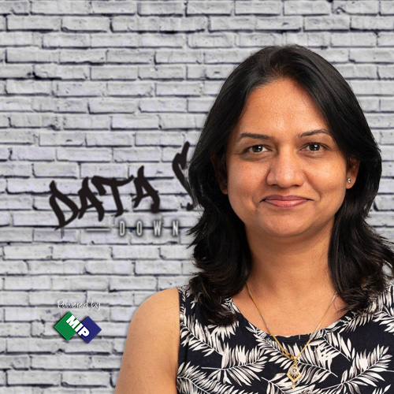
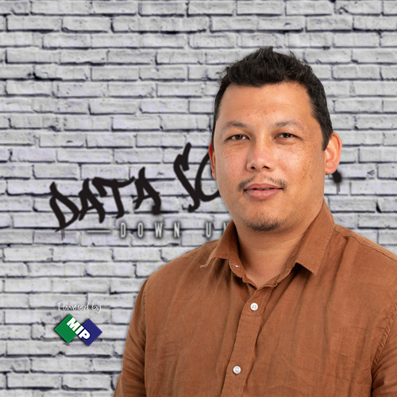
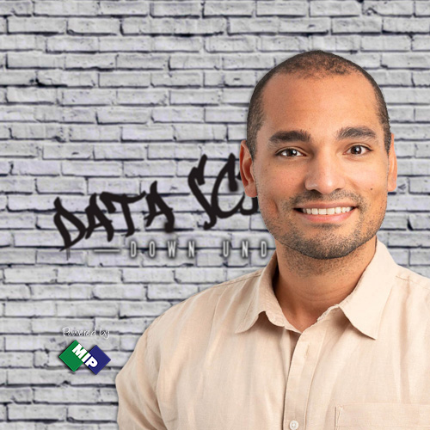



DATA SCHOOL CONSULTANTS
Team Leader
Team Member
Team Member
Team Member
Team Member
Team Member
Team Member
Pujiang Zhang
Nihal Peshwani
Aarti Nauhria
Wasnik Malla
Juan Cedano
Rodrigo Diaz
Kazi Rffat Hossain

Slide 6
DATA SCHOOL CONSULTANTS
Team Leader
Team Member
Team Member
Team Member
Team Member
Team Member
Team Member
Team Leader
Pujiang Zhang
Nihal Peshwani
Aarti Nauhria
Wasnik Malla
Juan Cedano
Rodrigo Diaz
Kazi Rffat Hossain
Pujiang Zhang

Slide 7
DATA SCHOOL CONSULTANTS
Team Leader
Team Member
Team Member
Team Member
Team Member
Team Member
Aarti Nauhria
Wasnik Malla
Juan Cedano
Rodrigo Diaz
Kazi Rffat Hossain
Pujiang Zhang
Nihal Peshwani
Aarti Nauhria
Kazi Riffat Hossain

Slide 8
DATA SCHOOL CONSULTANTS
Team Leader
Team Member
Team Member
Team Member
Team Member
Team Member
Aarti Nauhria
Wasnik Malla
Juan Cedano
Rodrigo Diaz
Kazi Rffat Hossain
Pujiang Zhang
Wasnik Malla
Juan Cedano
Rodrigo Diaz

Slide 9


Alteryx
Data preparation
Automation
Excel on steroids
Why Alteryx
Notes:
Tableau
"Tableau's first and foremost strength lies in its remarkable visualization capabilities. It stands out in the market by transforming complex raw data into interactive and intuitive dashboards. This superiority over traditional BI vendors highlights Tableau's innovative approach to data visualization, making it the preferred choice for enterprises seeking clear and actionable insights.“
"Another significant advantage of Tableau is its ease of use. The platform's intuitive drag-and-drop interface allows even those with no programming skills to generate deep insights quickly. This user-friendly nature democratizes data analytics, enabling a wider range of business users to make data-driven decisions without relying heavily on IT departments.“
"Tableau is renowned for its high performance, particularly when handling large datasets. Its robust and reliable engine ensures that users can process and analyze data efficiently, providing fast responses and reducing wait times for insights. This performance is crucial for organizations dealing with vast amounts of data.“
"The ability to connect with numerous data sources is a key feature of Tableau. Whether it's HADOOP, SAP, or other DB technologies, Tableau's flexibility in integrating diverse data sources allows businesses to aggregate and analyze data from across their entire operation, enhancing their analytical capabilities.“
"Lastly, Tableau excels in creating interactive visualizations and responsive dashboards. Its support for mobile devices ensures that stakeholders can access insights anytime, anywhere, making data-driven decisions more accessible. The platform's efficiency in managing large volumes of data without compromising performance further establishes Tableau as a leader in the field.“
Alteryx
"Alteryx shines in data preparation and blending, automating these critical yet time-consuming tasks. It efficiently combines data from varied sources, streamlining the analytical process and saving significant time.“
"A standout feature of Alteryx is its ability to automate workflows. Users can create repeatable, automated processes for their data analysis projects, enhancing efficiency and reducing the manual effort required for complex data tasks.“
"Ease of use is a key advantage of Alteryx, with its intuitive drag-and-drop interface. This design democratizes data analytics, allowing users to perform complex tasks more easily and encouraging broader engagement with data within organizations.“
"Lastly, Alteryx's ability to integrate seamlessly with other BI and analytics tools enhances its value. This interoperability facilitates a more comprehensive data analysis and visualization ecosystem, leveraging the strengths of Alteryx in conjunction with other platforms like Tableau."

Slide 10
Alteryx Demo
Notes:
Tableau
"Tableau's first and foremost strength lies in its remarkable visualization capabilities. It stands out in the market by transforming complex raw data into interactive and intuitive dashboards. This superiority over traditional BI vendors highlights Tableau's innovative approach to data visualization, making it the preferred choice for enterprises seeking clear and actionable insights.“
"Another significant advantage of Tableau is its ease of use. The platform's intuitive drag-and-drop interface allows even those with no programming skills to generate deep insights quickly. This user-friendly nature democratizes data analytics, enabling a wider range of business users to make data-driven decisions without relying heavily on IT departments.“
"Tableau is renowned for its high performance, particularly when handling large datasets. Its robust and reliable engine ensures that users can process and analyze data efficiently, providing fast responses and reducing wait times for insights. This performance is crucial for organizations dealing with vast amounts of data.“
"The ability to connect with numerous data sources is a key feature of Tableau. Whether it's HADOOP, SAP, or other DB technologies, Tableau's flexibility in integrating diverse data sources allows businesses to aggregate and analyze data from across their entire operation, enhancing their analytical capabilities.“
"Lastly, Tableau excels in creating interactive visualizations and responsive dashboards. Its support for mobile devices ensures that stakeholders can access insights anytime, anywhere, making data-driven decisions more accessible. The platform's efficiency in managing large volumes of data without compromising performance further establishes Tableau as a leader in the field.“
Alteryx
"Alteryx shines in data preparation and blending, automating these critical yet time-consuming tasks. It efficiently combines data from varied sources, streamlining the analytical process and saving significant time.“
"A standout feature of Alteryx is its ability to automate workflows. Users can create repeatable, automated processes for their data analysis projects, enhancing efficiency and reducing the manual effort required for complex data tasks.“
"Ease of use is a key advantage of Alteryx, with its intuitive drag-and-drop interface. This design democratizes data analytics, allowing users to perform complex tasks more easily and encouraging broader engagement with data within organizations.“
"Lastly, Alteryx's ability to integrate seamlessly with other BI and analytics tools enhances its value. This interoperability facilitates a more comprehensive data analysis and visualization ecosystem, leveraging the strengths of Alteryx in conjunction with other platforms like Tableau."

Slide 11
Tableau
Visualization
High performance
Multiple data connections
Interactive visualization
Why Tableau
Notes:
Tableau
"Tableau's first and foremost strength lies in its remarkable visualization capabilities. It stands out in the market by transforming complex raw data into interactive and intuitive dashboards. This superiority over traditional BI vendors highlights Tableau's innovative approach to data visualization, making it the preferred choice for enterprises seeking clear and actionable insights.“
"Another significant advantage of Tableau is its ease of use. The platform's intuitive drag-and-drop interface allows even those with no programming skills to generate deep insights quickly. This user-friendly nature democratizes data analytics, enabling a wider range of business users to make data-driven decisions without relying heavily on IT departments.“
"Tableau is renowned for its high performance, particularly when handling large datasets. Its robust and reliable engine ensures that users can process and analyze data efficiently, providing fast responses and reducing wait times for insights. This performance is crucial for organizations dealing with vast amounts of data.“
"The ability to connect with numerous data sources is a key feature of Tableau. Whether it's HADOOP, SAP, or other DB technologies, Tableau's flexibility in integrating diverse data sources allows businesses to aggregate and analyze data from across their entire operation, enhancing their analytical capabilities.“
"Lastly, Tableau excels in creating interactive visualizations and responsive dashboards. Its support for mobile devices ensures that stakeholders can access insights anytime, anywhere, making data-driven decisions more accessible. The platform's efficiency in managing large volumes of data without compromising performance further establishes Tableau as a leader in the field.“
Alteryx
"Alteryx shines in data preparation and blending, automating these critical yet time-consuming tasks. It efficiently combines data from varied sources, streamlining the analytical process and saving significant time.“
"A standout feature of Alteryx is its ability to automate workflows. Users can create repeatable, automated processes for their data analysis projects, enhancing efficiency and reducing the manual effort required for complex data tasks.“
"Ease of use is a key advantage of Alteryx, with its intuitive drag-and-drop interface. This design democratizes data analytics, allowing users to perform complex tasks more easily and encouraging broader engagement with data within organizations.“
"Lastly, Alteryx's ability to integrate seamlessly with other BI and analytics tools enhances its value. This interoperability facilitates a more comprehensive data analysis and visualization ecosystem, leveraging the strengths of Alteryx in conjunction with other platforms like Tableau."

Slide 12
Tableau Demo
Notes:
Tableau
"Tableau's first and foremost strength lies in its remarkable visualization capabilities. It stands out in the market by transforming complex raw data into interactive and intuitive dashboards. This superiority over traditional BI vendors highlights Tableau's innovative approach to data visualization, making it the preferred choice for enterprises seeking clear and actionable insights.“
"Another significant advantage of Tableau is its ease of use. The platform's intuitive drag-and-drop interface allows even those with no programming skills to generate deep insights quickly. This user-friendly nature democratizes data analytics, enabling a wider range of business users to make data-driven decisions without relying heavily on IT departments.“
"Tableau is renowned for its high performance, particularly when handling large datasets. Its robust and reliable engine ensures that users can process and analyze data efficiently, providing fast responses and reducing wait times for insights. This performance is crucial for organizations dealing with vast amounts of data.“
"The ability to connect with numerous data sources is a key feature of Tableau. Whether it's HADOOP, SAP, or other DB technologies, Tableau's flexibility in integrating diverse data sources allows businesses to aggregate and analyze data from across their entire operation, enhancing their analytical capabilities.“
"Lastly, Tableau excels in creating interactive visualizations and responsive dashboards. Its support for mobile devices ensures that stakeholders can access insights anytime, anywhere, making data-driven decisions more accessible. The platform's efficiency in managing large volumes of data without compromising performance further establishes Tableau as a leader in the field.“
Alteryx
"Alteryx shines in data preparation and blending, automating these critical yet time-consuming tasks. It efficiently combines data from varied sources, streamlining the analytical process and saving significant time.“
"A standout feature of Alteryx is its ability to automate workflows. Users can create repeatable, automated processes for their data analysis projects, enhancing efficiency and reducing the manual effort required for complex data tasks.“
"Ease of use is a key advantage of Alteryx, with its intuitive drag-and-drop interface. This design democratizes data analytics, allowing users to perform complex tasks more easily and encouraging broader engagement with data within organizations.“
"Lastly, Alteryx's ability to integrate seamlessly with other BI and analytics tools enhances its value. This interoperability facilitates a more comprehensive data analysis and visualization ecosystem, leveraging the strengths of Alteryx in conjunction with other platforms like Tableau."

Slide 13
Q & A
Notes:
Tableau
"Tableau's first and foremost strength lies in its remarkable visualization capabilities. It stands out in the market by transforming complex raw data into interactive and intuitive dashboards. This superiority over traditional BI vendors highlights Tableau's innovative approach to data visualization, making it the preferred choice for enterprises seeking clear and actionable insights.“
"Another significant advantage of Tableau is its ease of use. The platform's intuitive drag-and-drop interface allows even those with no programming skills to generate deep insights quickly. This user-friendly nature democratizes data analytics, enabling a wider range of business users to make data-driven decisions without relying heavily on IT departments.“
"Tableau is renowned for its high performance, particularly when handling large datasets. Its robust and reliable engine ensures that users can process and analyze data efficiently, providing fast responses and reducing wait times for insights. This performance is crucial for organizations dealing with vast amounts of data.“
"The ability to connect with numerous data sources is a key feature of Tableau. Whether it's HADOOP, SAP, or other DB technologies, Tableau's flexibility in integrating diverse data sources allows businesses to aggregate and analyze data from across their entire operation, enhancing their analytical capabilities.“
"Lastly, Tableau excels in creating interactive visualizations and responsive dashboards. Its support for mobile devices ensures that stakeholders can access insights anytime, anywhere, making data-driven decisions more accessible. The platform's efficiency in managing large volumes of data without compromising performance further establishes Tableau as a leader in the field.“
Alteryx
"Alteryx shines in data preparation and blending, automating these critical yet time-consuming tasks. It efficiently combines data from varied sources, streamlining the analytical process and saving significant time.“
"A standout feature of Alteryx is its ability to automate workflows. Users can create repeatable, automated processes for their data analysis projects, enhancing efficiency and reducing the manual effort required for complex data tasks.“
"Ease of use is a key advantage of Alteryx, with its intuitive drag-and-drop interface. This design democratizes data analytics, allowing users to perform complex tasks more easily and encouraging broader engagement with data within organizations.“
"Lastly, Alteryx's ability to integrate seamlessly with other BI and analytics tools enhances its value. This interoperability facilitates a more comprehensive data analysis and visualization ecosystem, leveraging the strengths of Alteryx in conjunction with other platforms like Tableau."

Slide 14

THE PROCESS / THE WORKFLOW
LOADING
STAGING
STORING

